Slide 1


UNIT 4: Clocks and calendars
What does a teacher do?

Slide 2



Use the PowerPoint presentation Jobs and name the jobs you can see.
Textbook, p. 72
Which jobs can you name?
Listen and underline the verbs in the text.

Slide 3
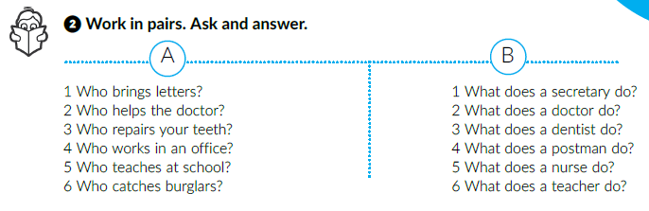
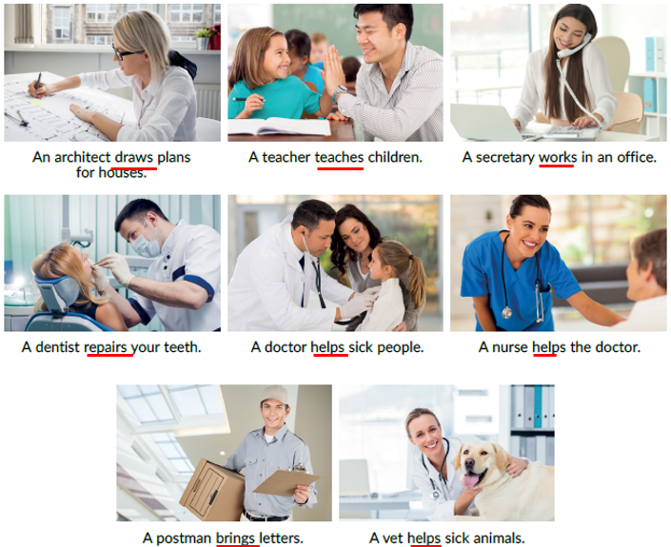
Work in pairs. Read the text again and complete the task.
Look at the underlined words.
What kind of words are they?
What tense is it?
Verbs.
Present Simple tense.
Is there something special about these verbs?
There is a suffix –s/ -es

Slide 4
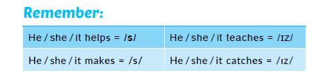
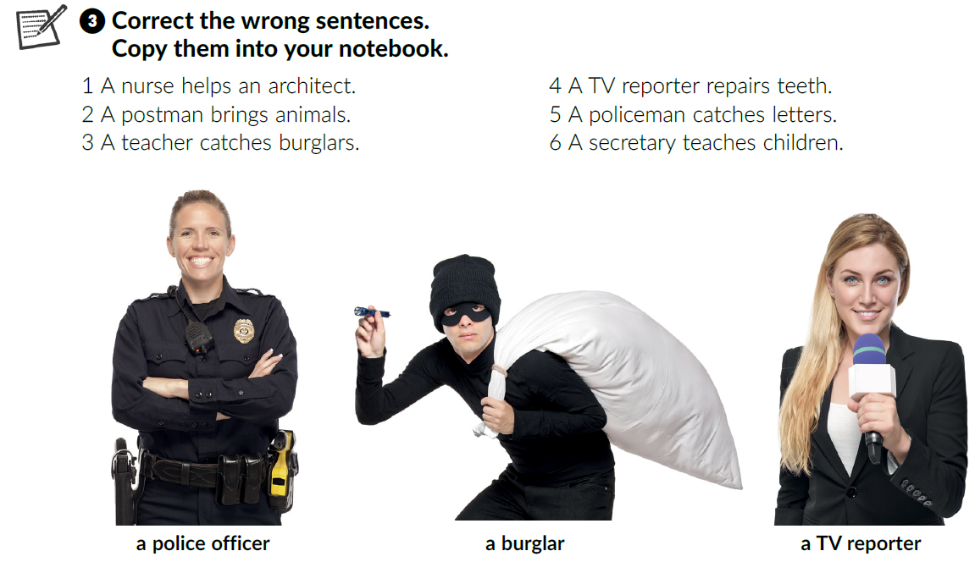
1 A nurse helps a doctor.
2 A postman brings
letters.
3 A teacher teaches children.
4 A dentist repairs teeth.
5 A policeman catches burglars.
6 A secretary works in an office.

Slide 5
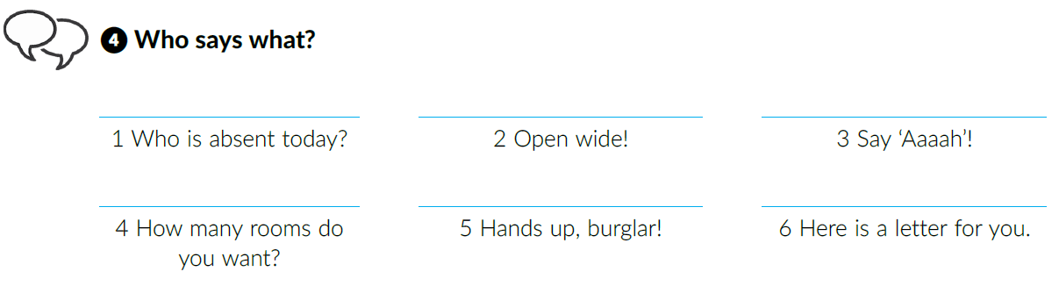

A teacher
A dentist
A doctor
An architect
A policeman
A postman
Click on the following link and choose Learn more: A school interview. Read the text and complete the tasks below.
https://www.e-sfera.hr/dodatni-digitalni-sadrzaji/ec038815-279b-46e1-92a1-c96b22046bc9/

Slide 6

5
What about your family members? What do they do?
7
6
8
Click on the following link and choose Learn more: Many skills for one job. Read the text. Can you name the job?
https://www.e-sfera.hr/dodatni-digitalni-sadrzaji/ec038815-279b-46e1-92a1-c96b22046bc9/
1
3
2
4
9

Slide 7
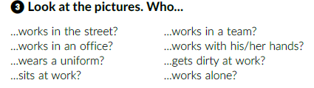

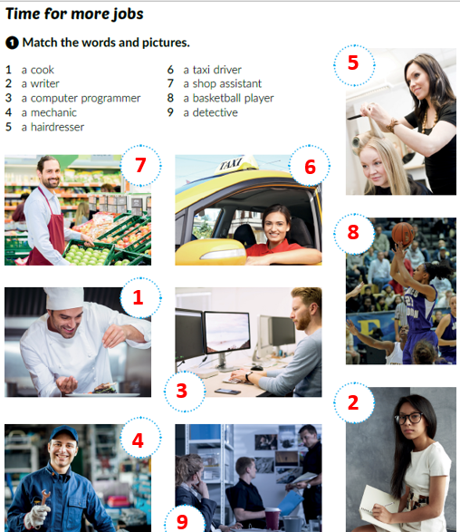
What is your favourite job and why?

Slide 8
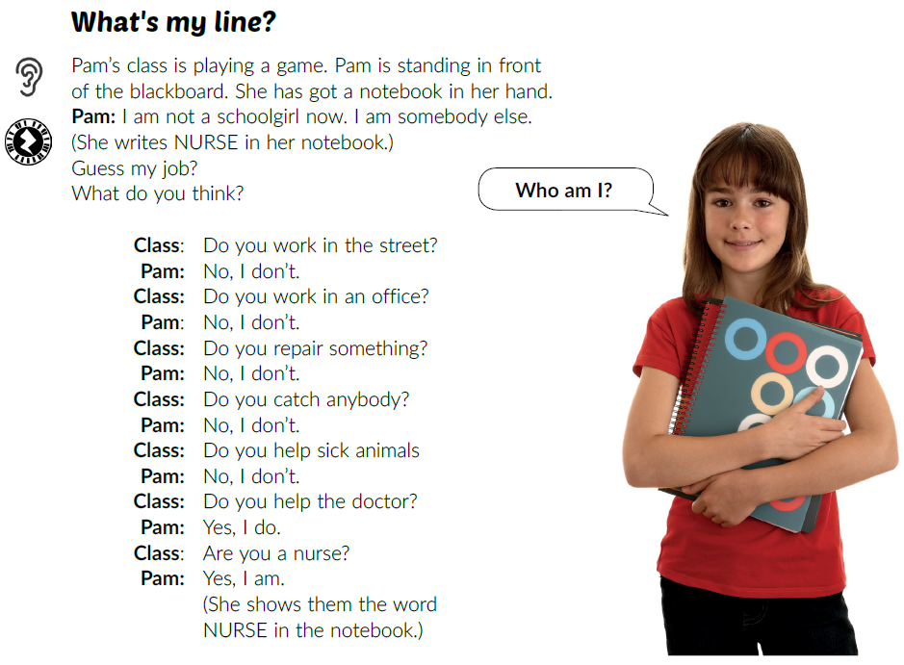
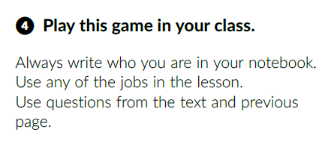
Listen and explain the rules of the game.
Let’s play!

Slide 9
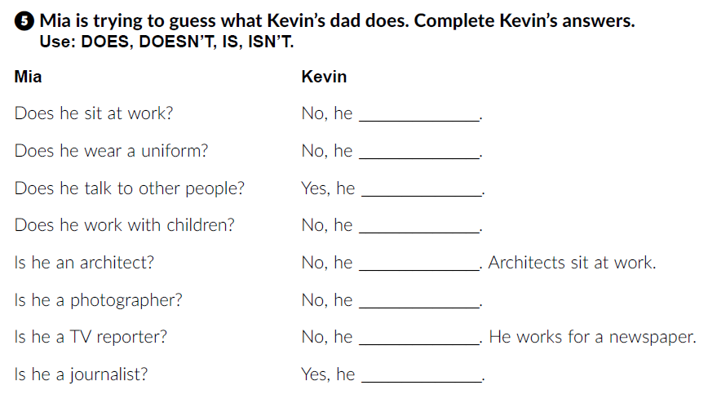
Workbook, p. 53
doesn’t
doesn’t
does
doesn’t
isn’t
isn’t
isn’t
is

Slide 10
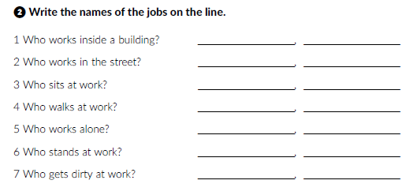
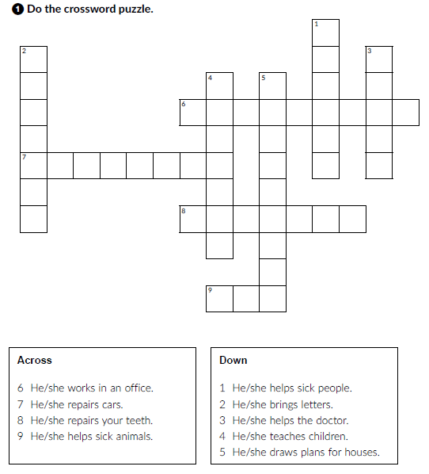
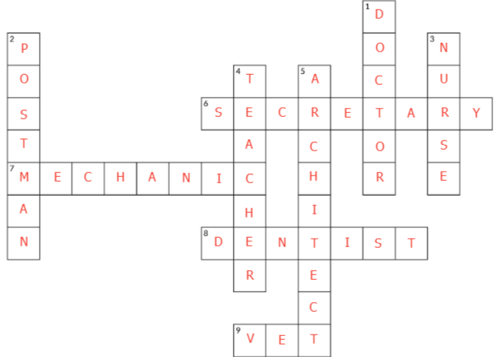
Workbook p. 51 and 52

Slide 11
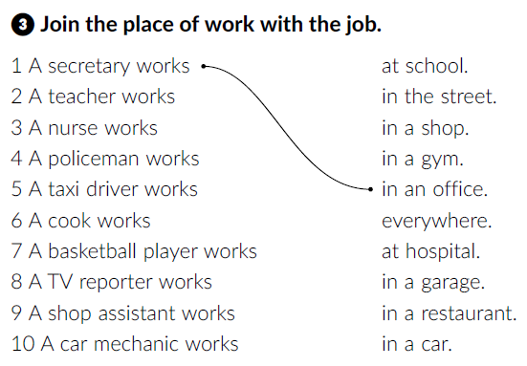
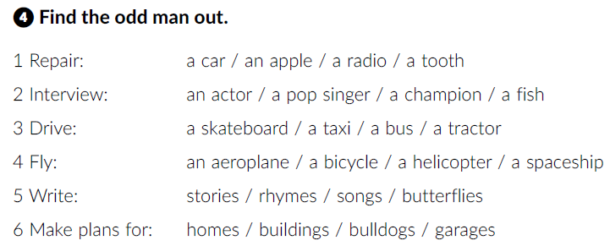
2
4
9
7
8
3
10
6
5

